Slide 1
Support Vector Machines
Amal Joseph
Machine Learning Engineer @ Arcesium

Slide 2
Overview
Support Vector Machines Intuition
Types of SVMs

Slide 3
Support Vector Machines
A supervised machine learning problem where we try to find a hyperplane that best separates the two classes.
It chooses the line that separates the data and is the furthest away from the closet data points as possible.

Slide 4
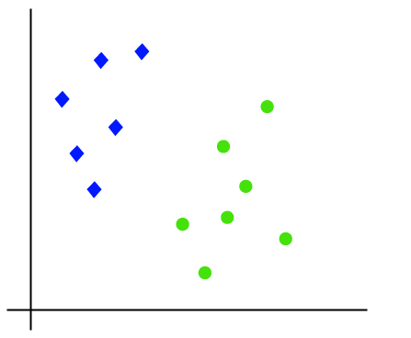

Slide 5
you're trying to find the line between the two closest points that keeps the other data points separated.

Slide 6
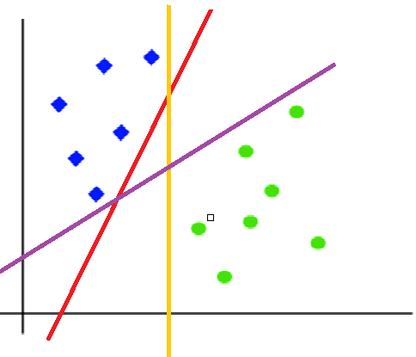

Slide 7
The best hyperplane is that plane that has the maximum distance from both the classes, and this is the main aim of SVM.
This is done by finding different hyperplanes which classify the labels in the best way then it will choose the one which is farthest from the data points or the one which has a maximum margin.

Slide 8
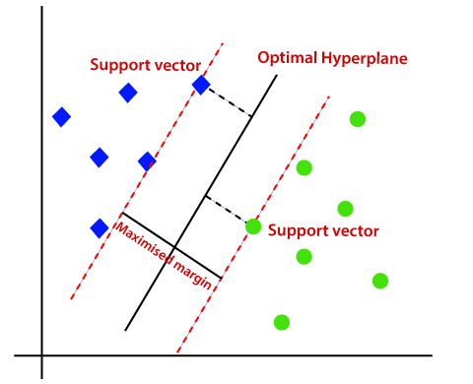

Slide 9
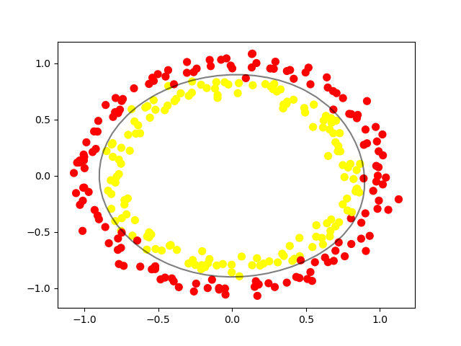
The decision boundary doesn't have to be a line.
It's also referred to as a hyperplane because you can find the decision boundary with any number of features, not just two.

Slide 10
Types of SVMs
Linear SVM
When the data is perfectly linearly separable only then we can use Linear SVM. Perfectly linearly separable means that the data points can be classified into 2 classes by using a single straight line(if 2D).
Non-Linear SVM
When the data is not linearly separable then we can use Non-Linear SVM, which means when the data points cannot be separated into 2 classes by using a straight line (if 2D) then we use some advanced techniques like kernel tricks to classify them.
In most real-world applications we do not find linearly separable data points hence we use kernel trick to solve them.

